Slide 1
Pro:Centric Direct VMware Installation Guide (unofficial)

Slide 2
There are many Pro:Centric Direct (PCD) versions. PCD 2.0 ~ PCD 5.0. (it jumps by 0.5).
Hotels are using typically PCD version 3.5 and above. I suggest you to install all of them.
Pro:Centric Direct (PCD) runs on PCS400, PCS500 or Dell, HP server. Since you do not have server, here is the alternative way to install PCD though it is not official.
Before you start, please Install Oracle VM virtual BOX. I am currently using version 6.1
Download iso file PCD 5.0 iso file https://signup.lge.com/Update/Update_Release/ProCentric/Phoenix/Daily/mnt/procentric/ISOs/ProCentric-5.0-1646706384-251.iso

Slide 3
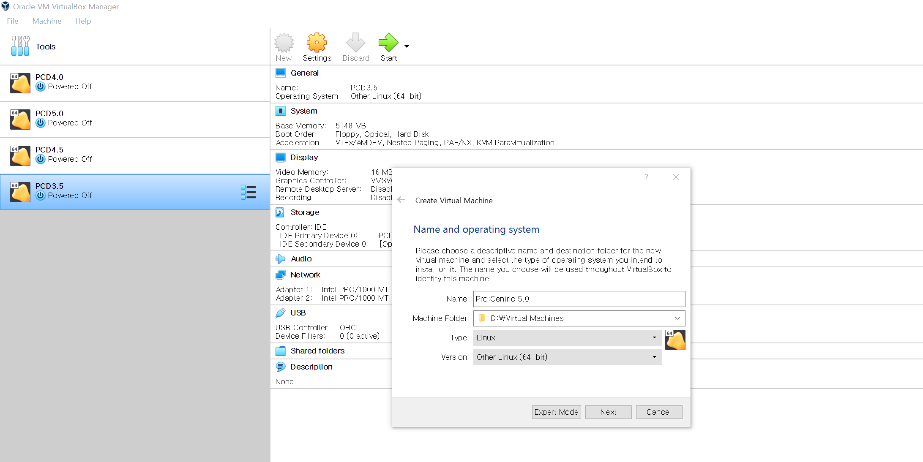
1. Click new (name it Pro:Centric 5.0)

Slide 4
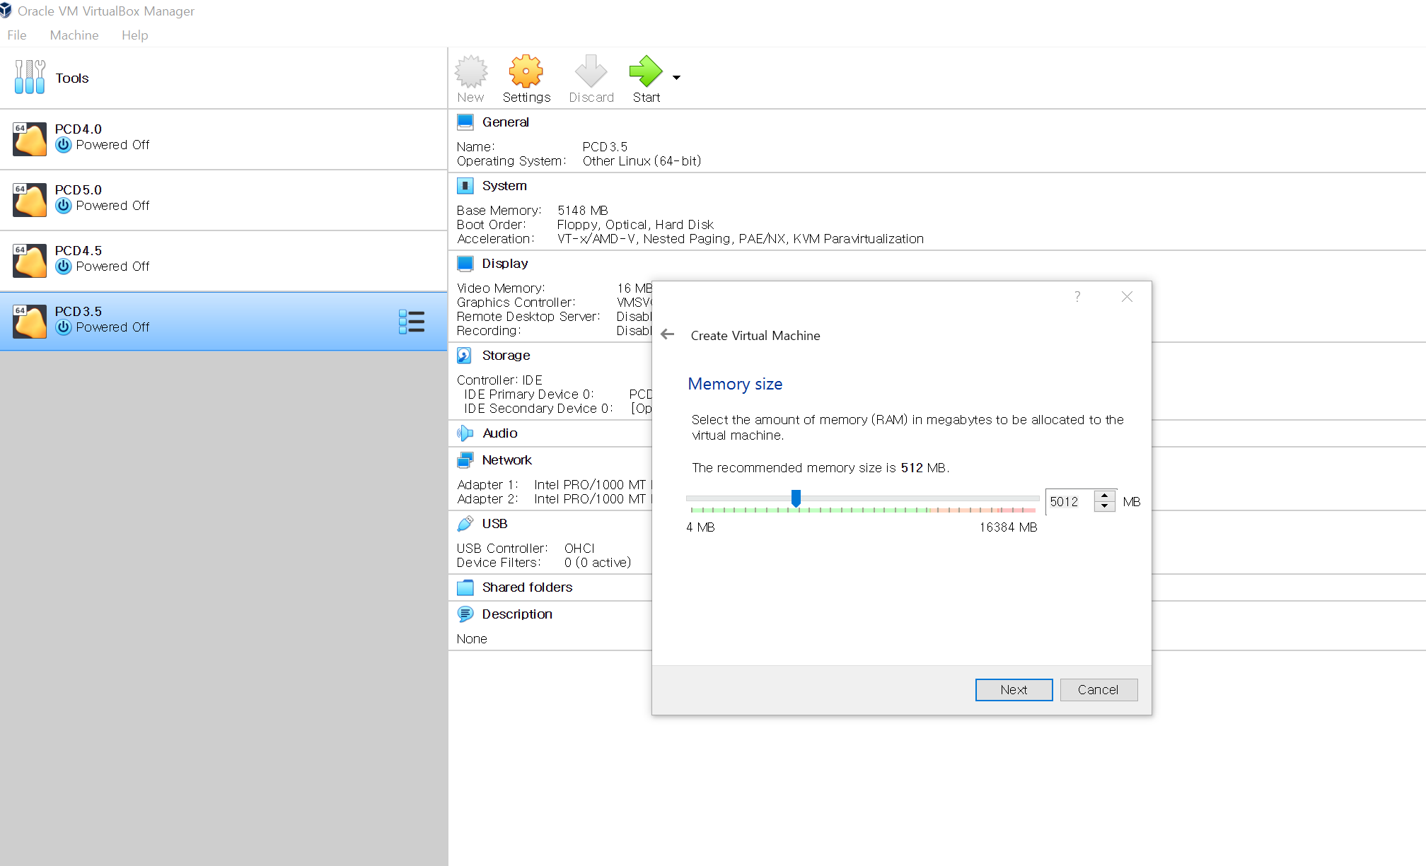
2. Set memory size (greater than 4096 should be enough)

Slide 5
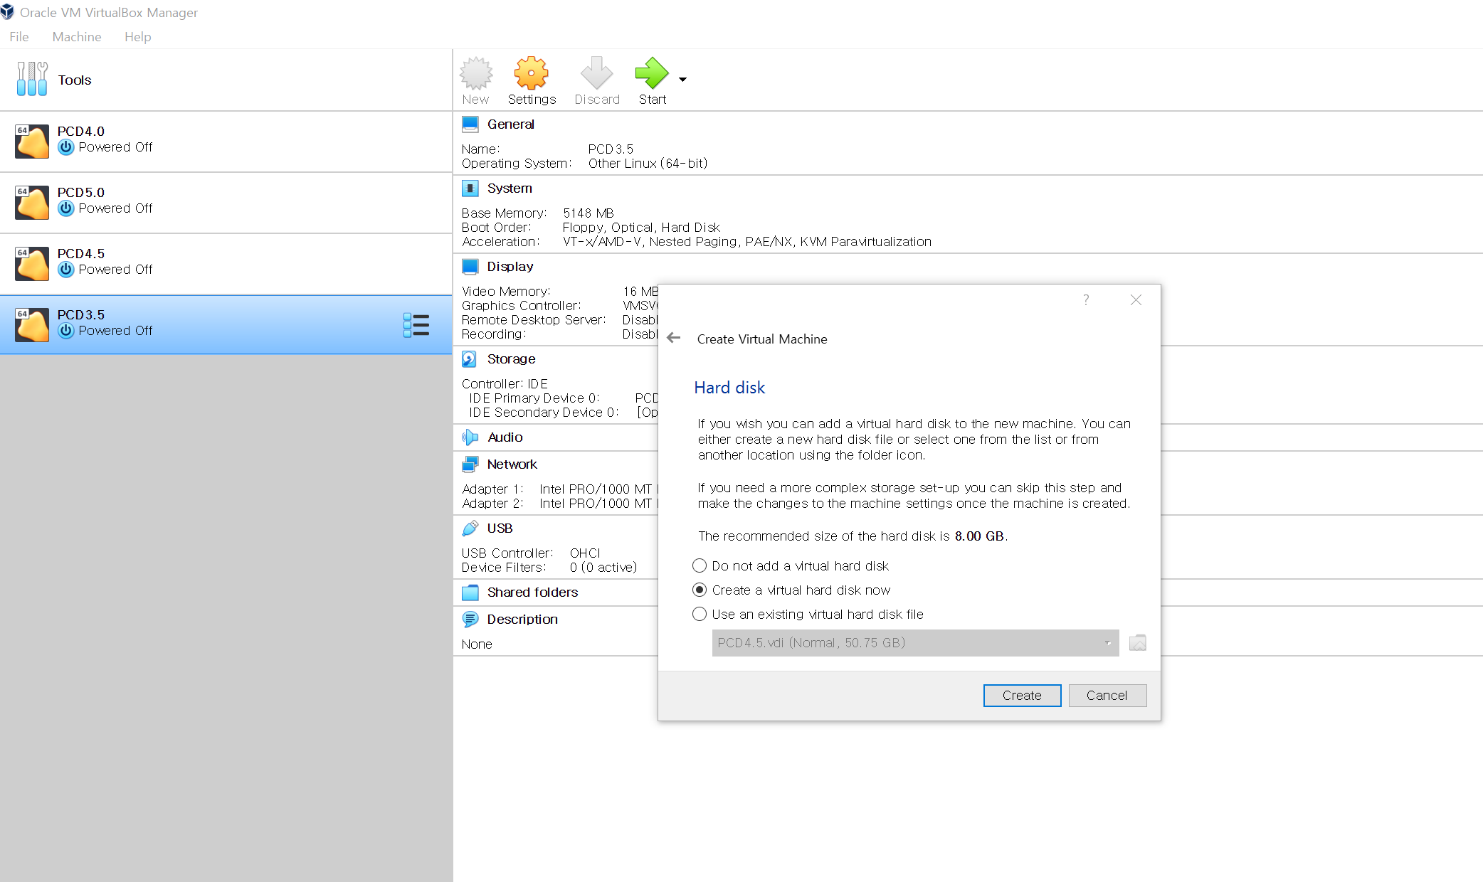
3. Select virtual hard disk

Slide 6
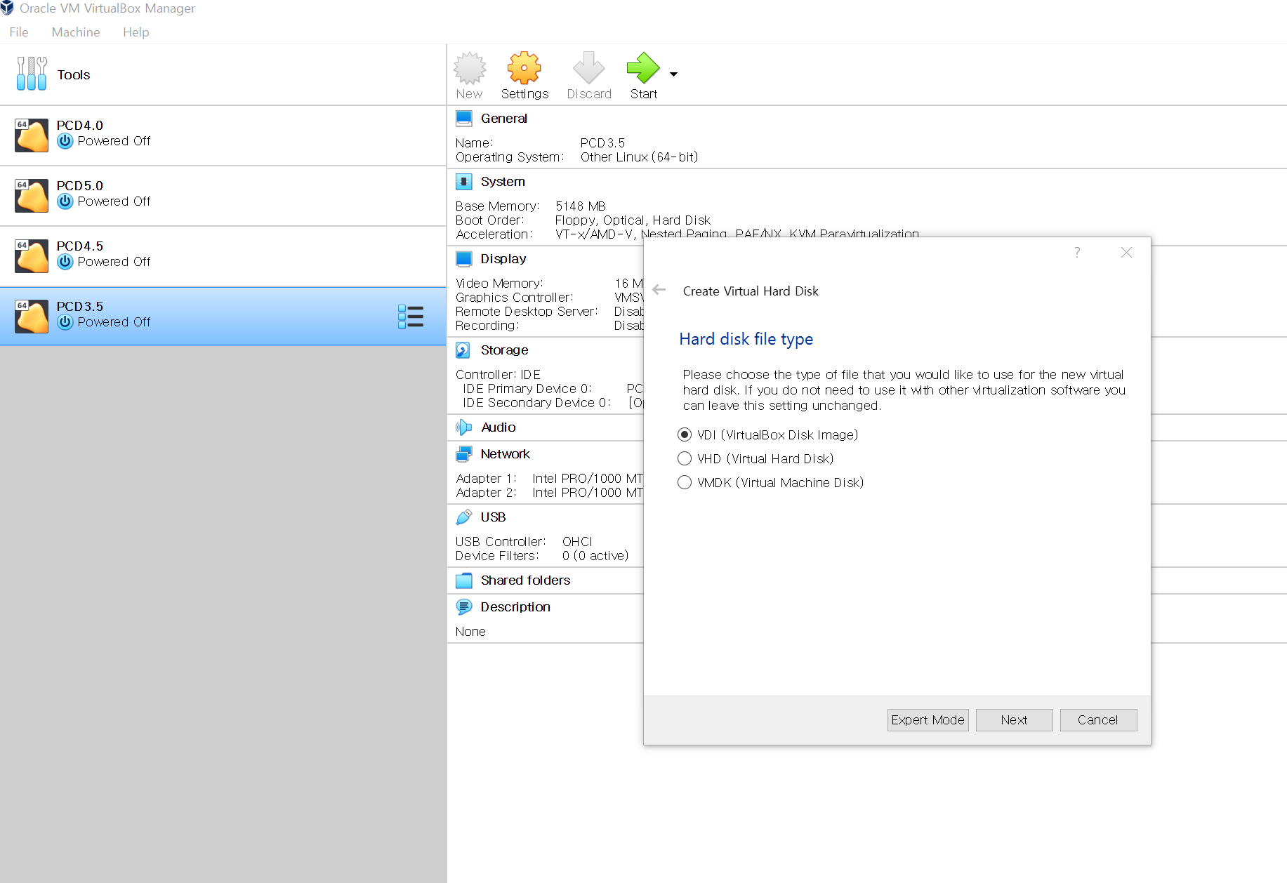
4. Select VDI as hard disk file type

Slide 7
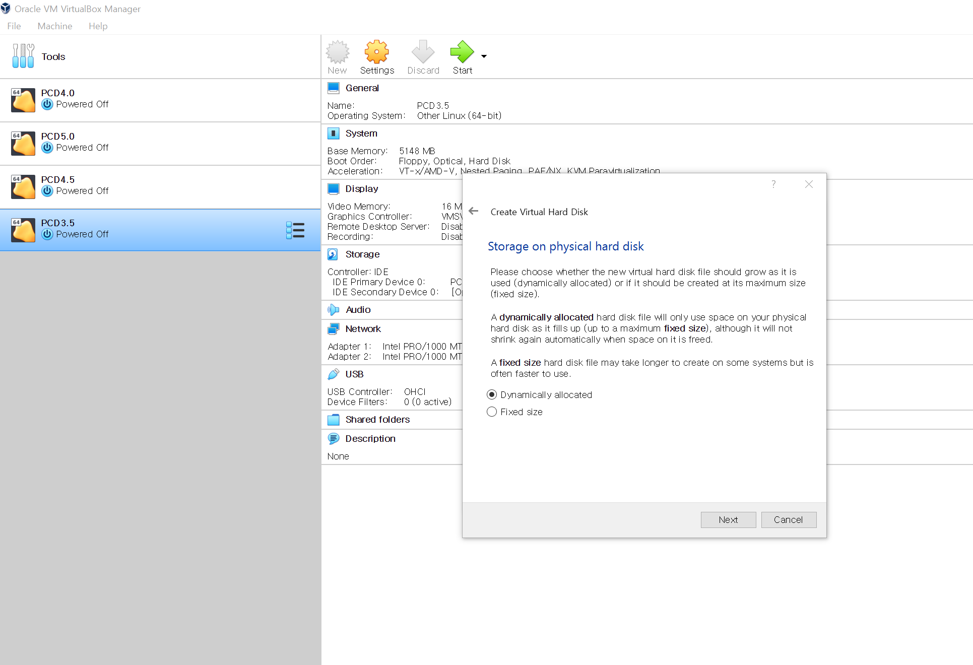
5. Select Dynamically allocated.

Slide 8
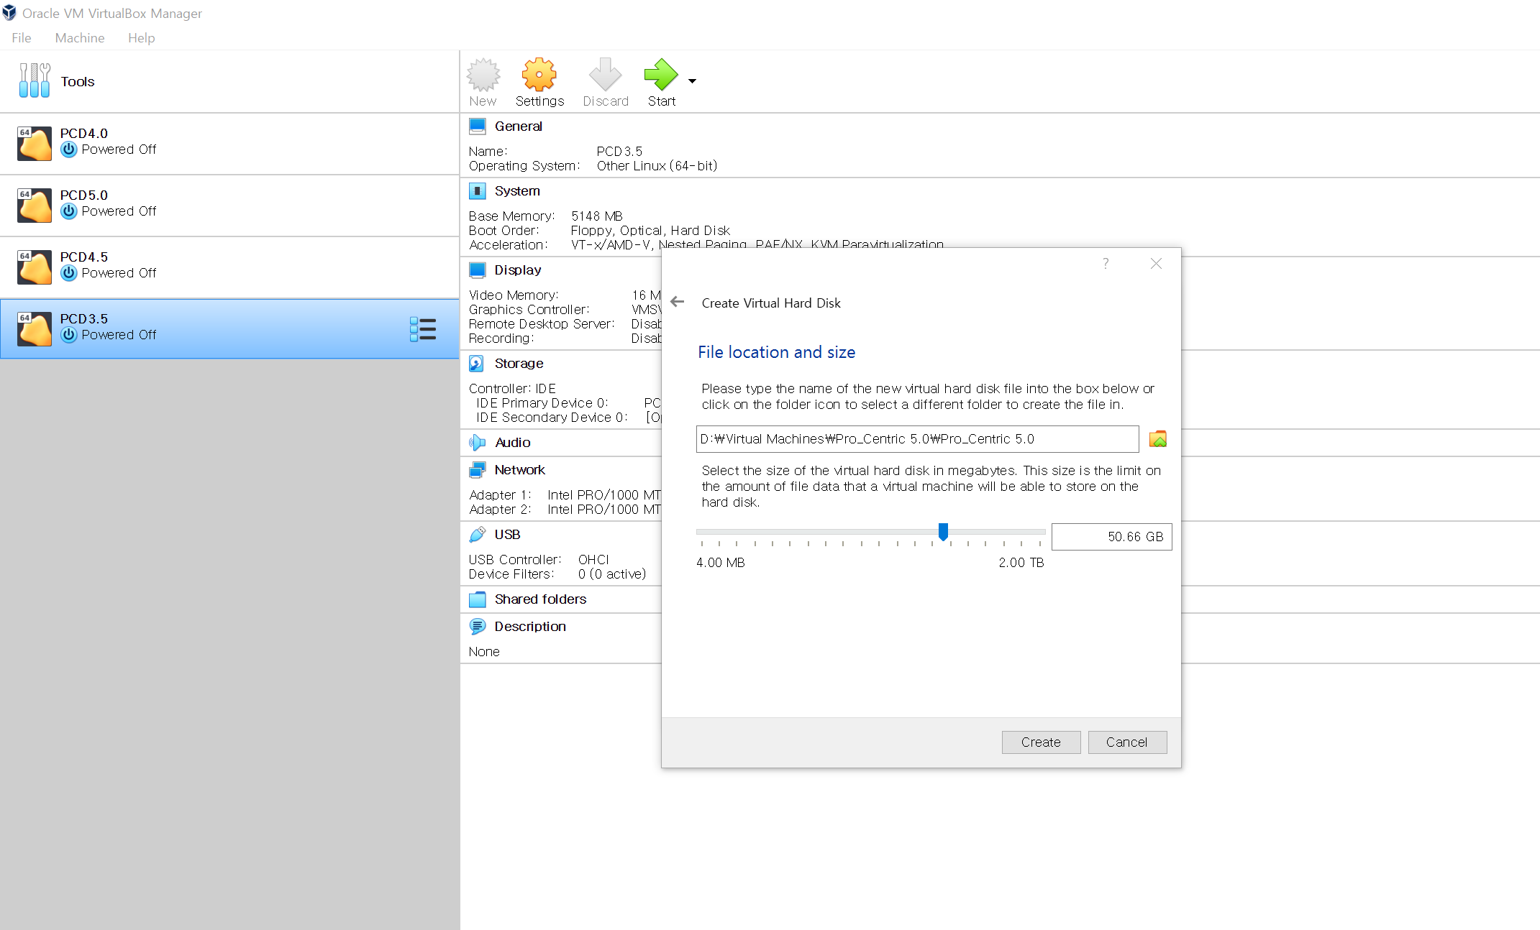
6. Select hard disk size. (greater than 50GB should be enough)

Slide 9
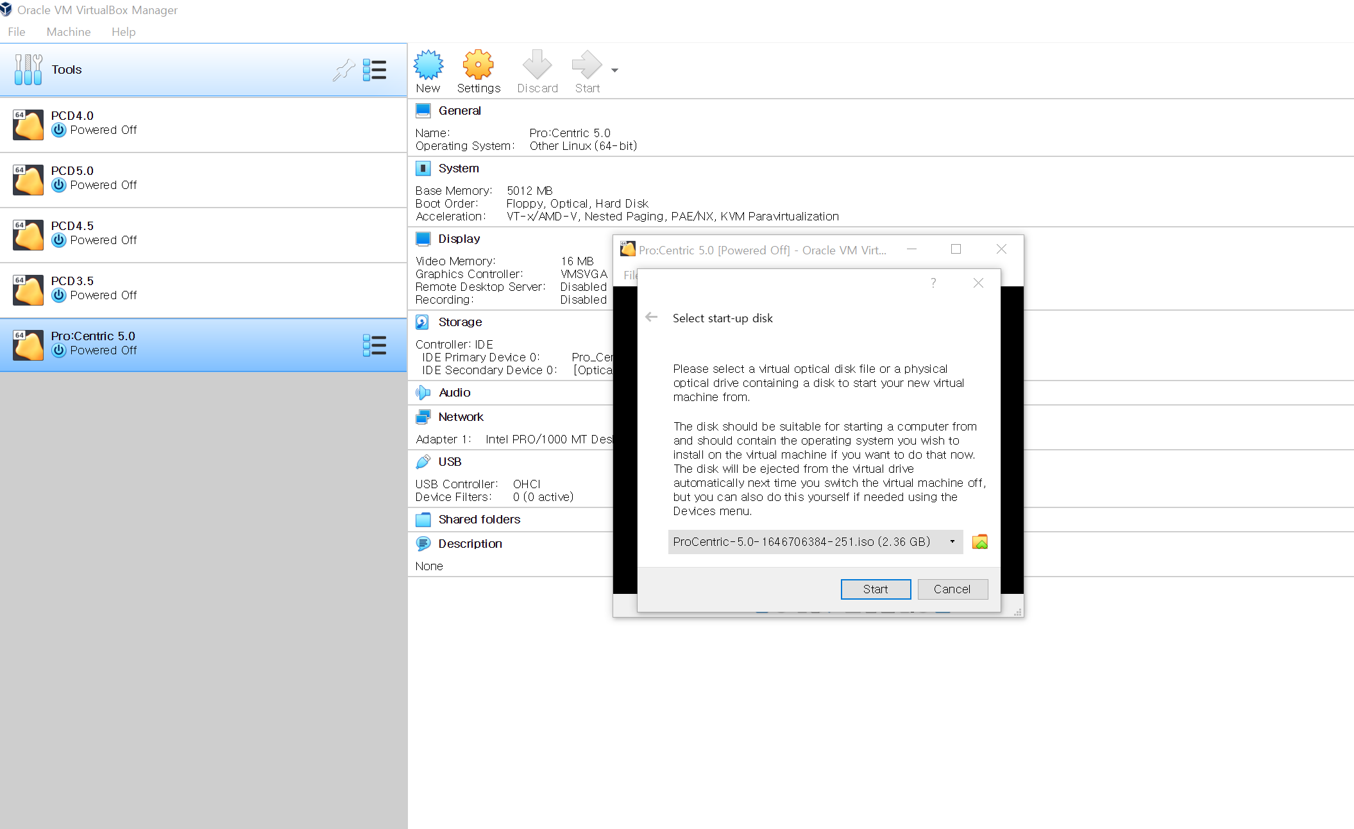
7. Double click Pro:Centric 5.0 from left panel. Select iso file. (https://signup.lge.com/Update/Update_Release/ProCentric/Phoenix/Daily/mnt/procentric/ISOs/ProCentric-5.0-1646706384-251.iso)

Slide 10
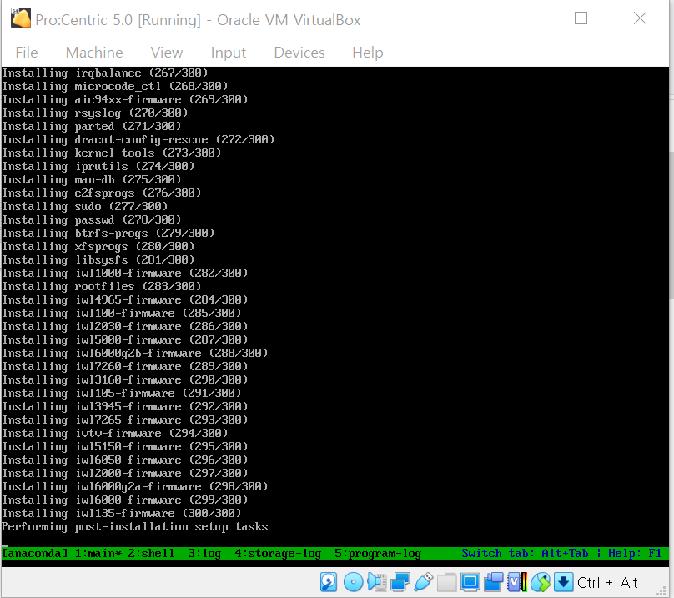
8. Installation begins

Slide 11
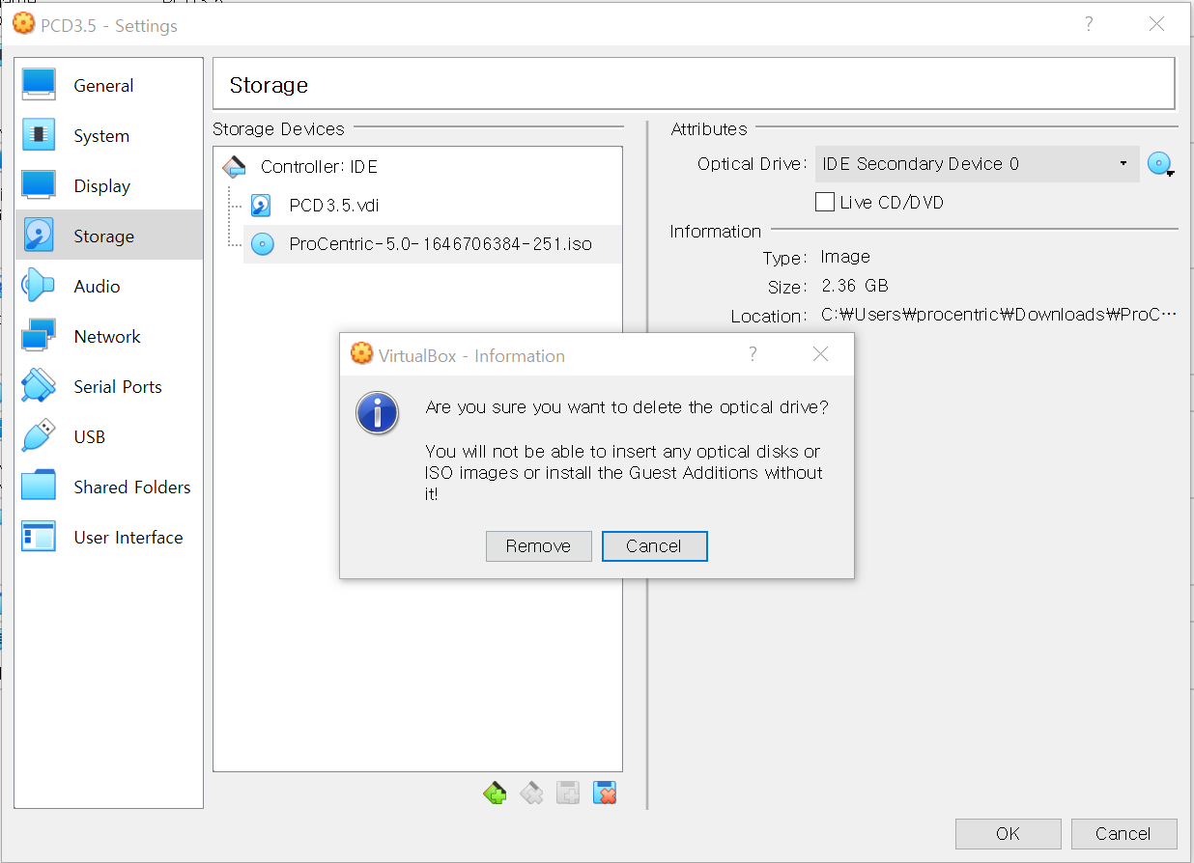
9. In about 5~10 minutes you vm machine will power off automatically. When it does, extract iso file you inserted in step 10. (right click-> settings -> storage -> remove ProCentric-5.0-16xxxxxx.iso).

Slide 12
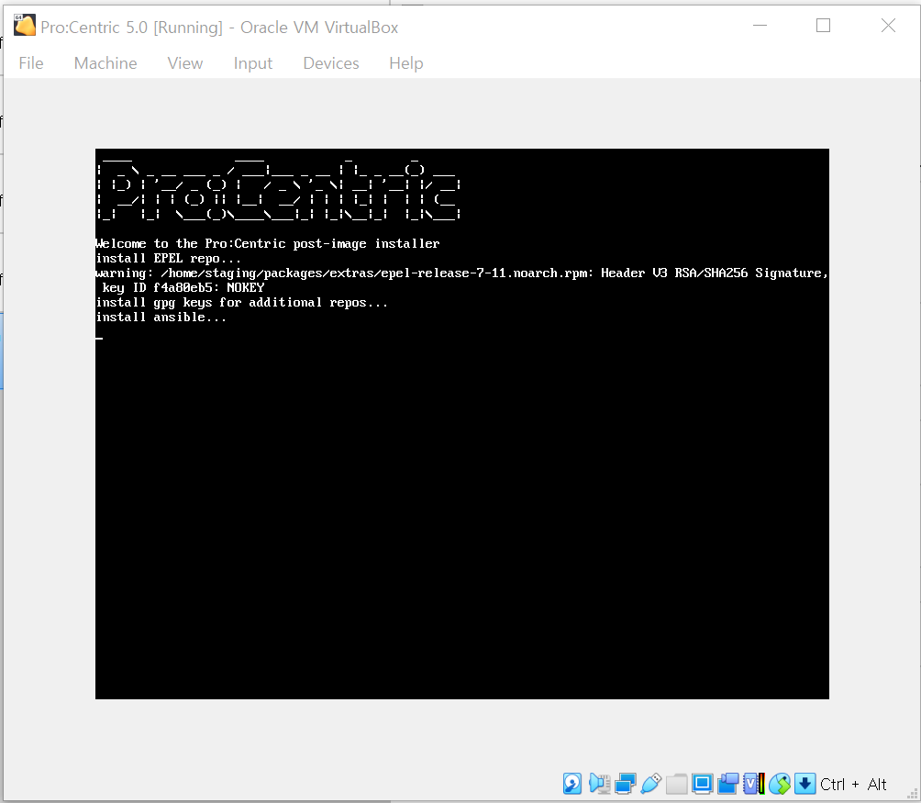
10. Power on vm machine and proceed installing. takes about (20~30 mins)

Slide 13
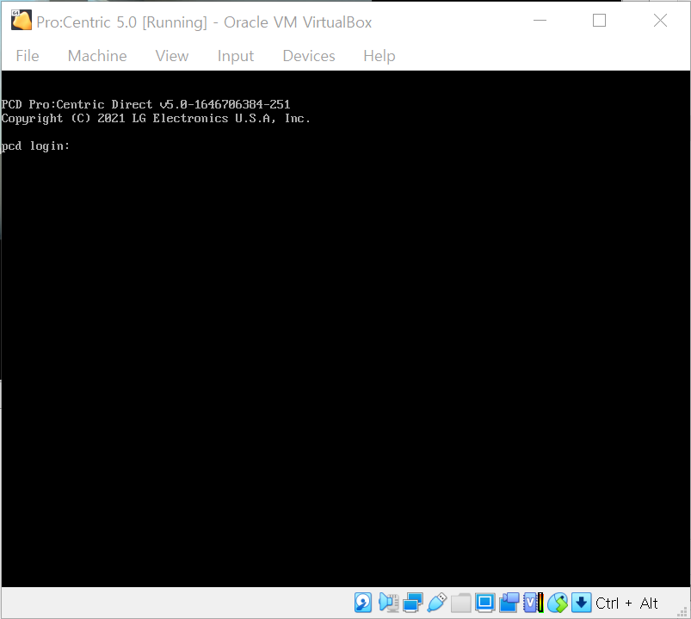
11. Once installation is done, it should be like this.

Slide 14
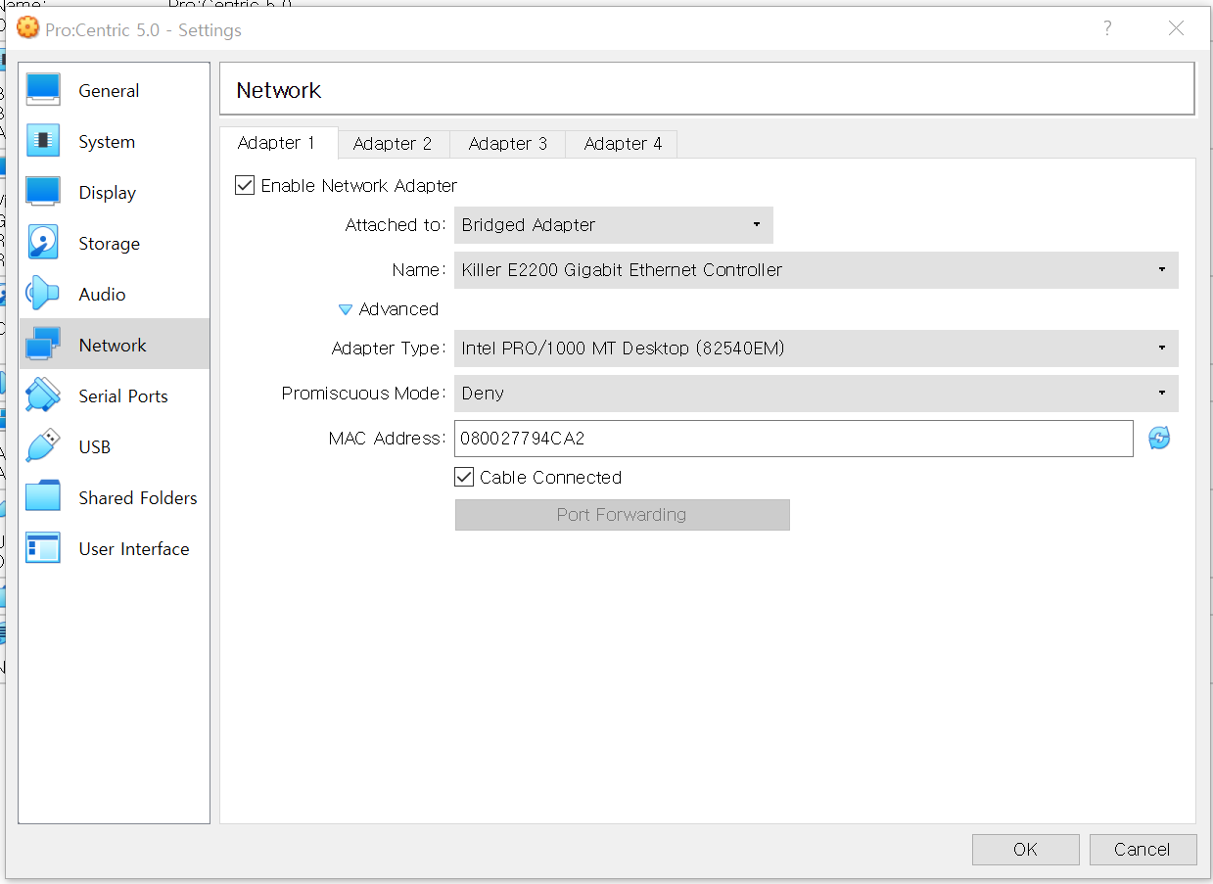
12. Then power off VM machine, settings > network > Adaptor 1, Then Enable network and set it as Bridged Adaptor.

Slide 15
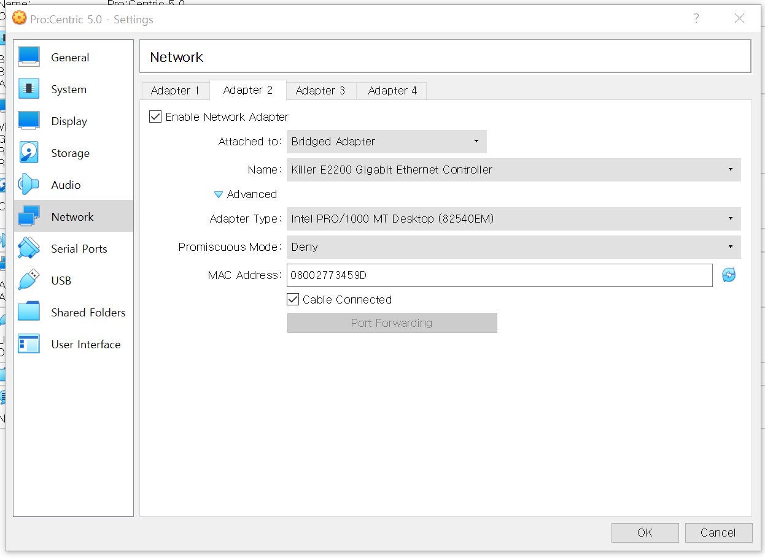
13. go to Adaptor 2, Enable network and set it as Bridged Adaptor (same as Adaptor 1).

Slide 16
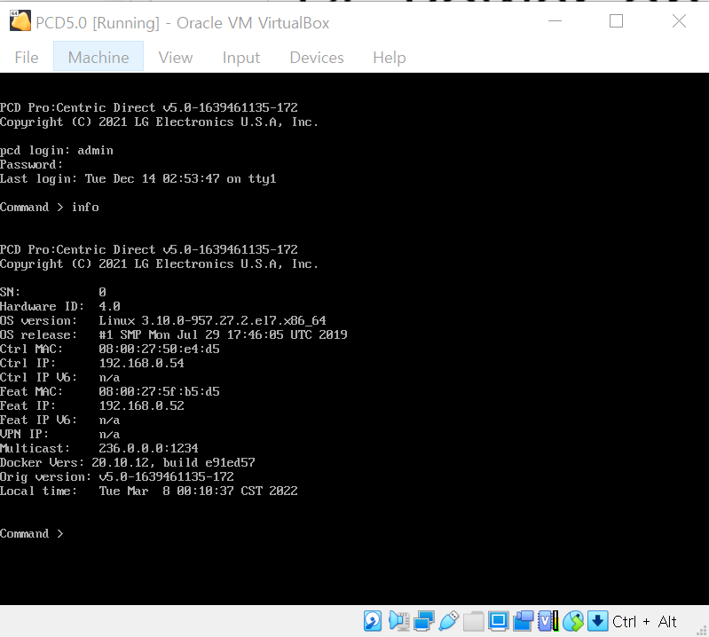
14. Power on your virtual machine. - Log in as admin / Password4Partners - Type ‘info’ - You should be able to see Feature / Control IP address

Slide 17
Acquire Root Access on CentOS Machine

Slide 18
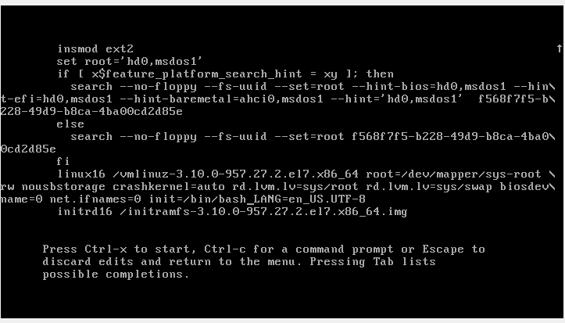
1. Reboot VM ware. press 'e' untill you see below screen

Slide 19
2. replace 'ro' => 'rw', 'rhgb quiet' => 'init=/bin/bash‘ then Press CTRL+x

Slide 20
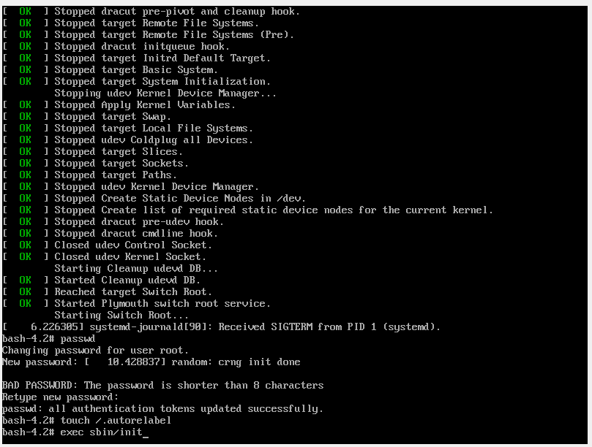
3. Change Password - type ‘passwd’ - enter password you wish to change - type again - type /.autorelabel - type sbin/init

Slide 21
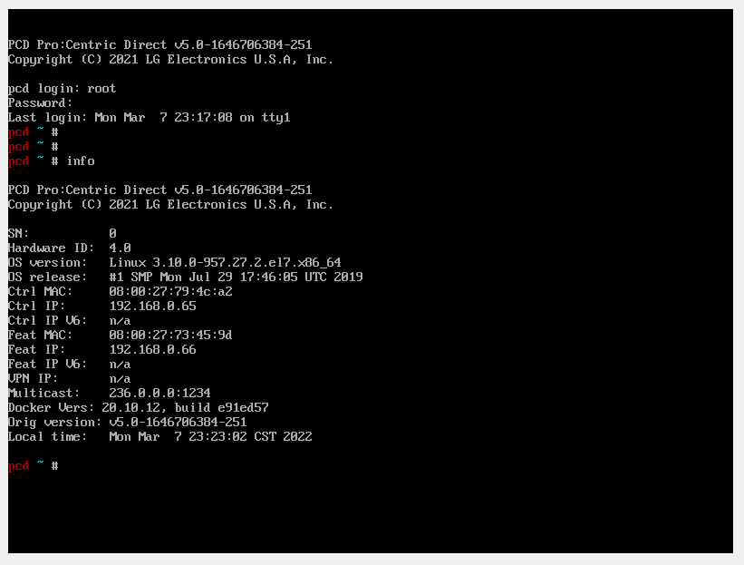
4. once it reboots, log in as root. then type info - You should be able to see feature / control ip address.

Slide 22
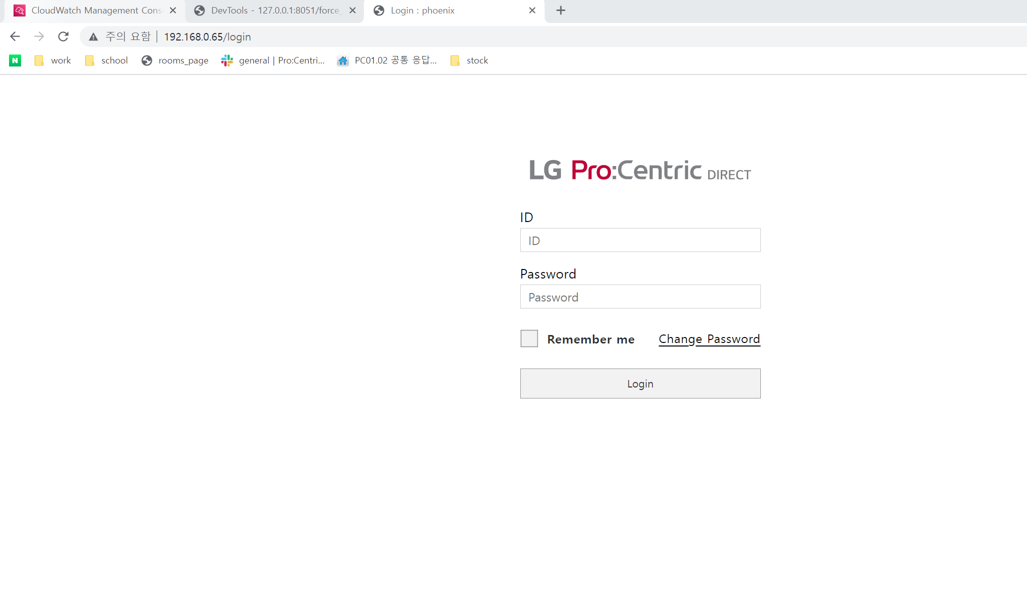
5. Type control ip address on your chrome browser.

Slide 23
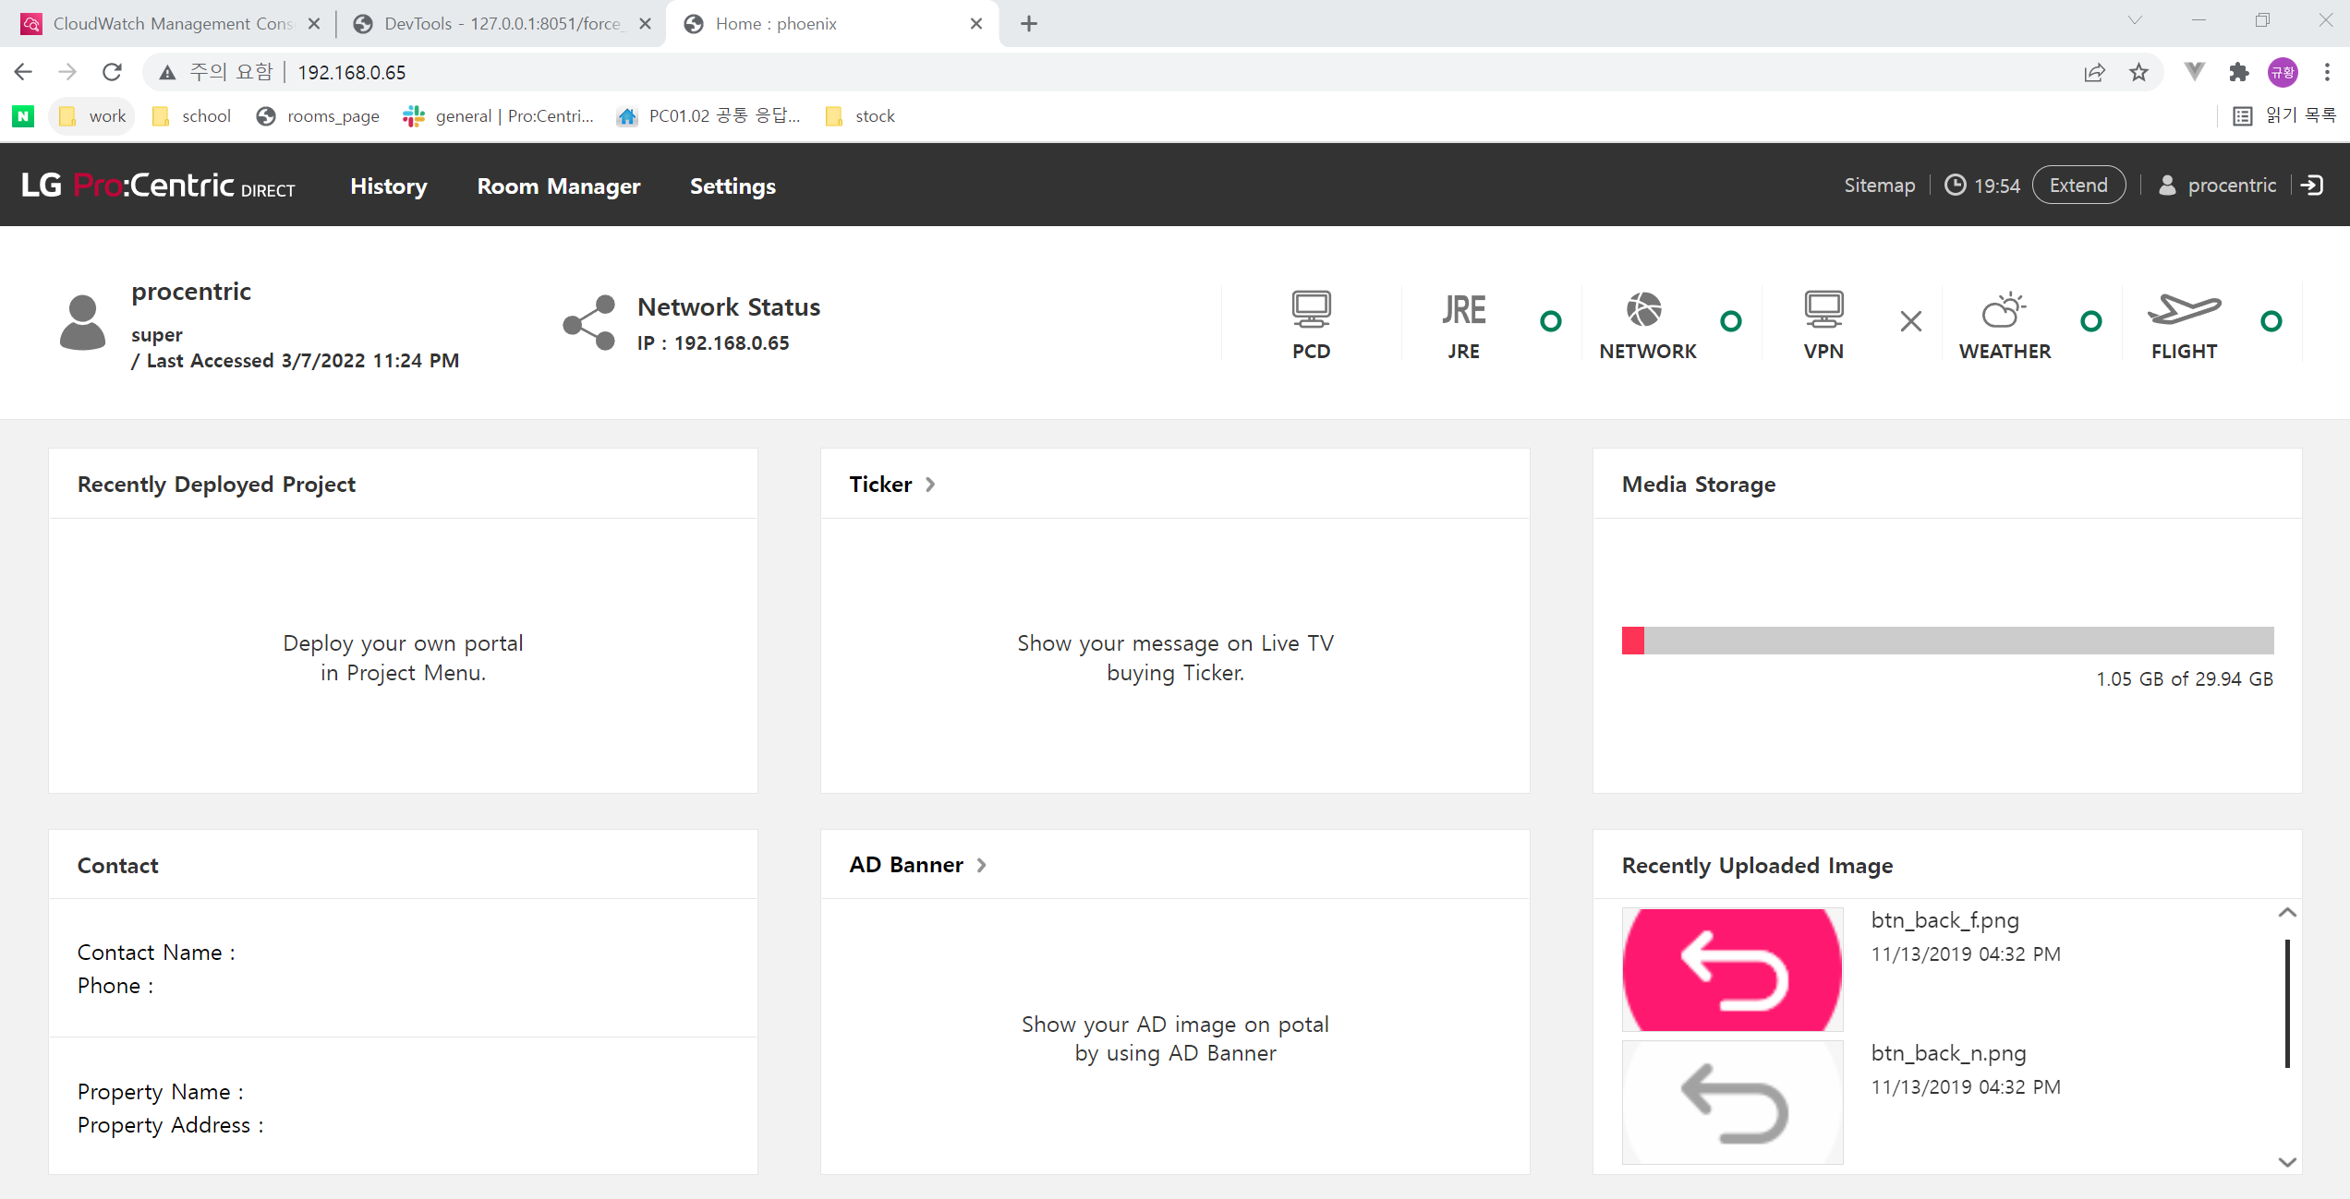
6. login as procentric / Password4Partners - If you see below screen, installation is finished.

